Slide 1
Emotional Annotation of Text
David Gallagher

Slide 2
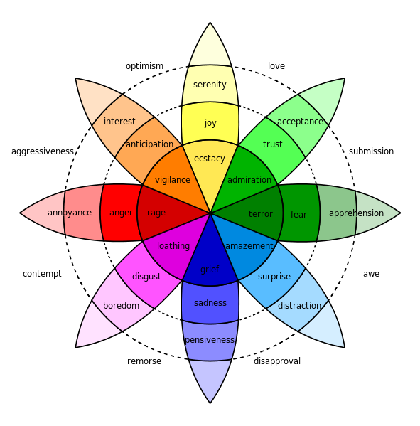
What is Emotional Annotation of Text?
Emotion complexity
Emotional connotation
Approaches
Emotional Categories
“Bag of Words”
Emotional Dimensions
Plutchik’s Wheel

Slide 3
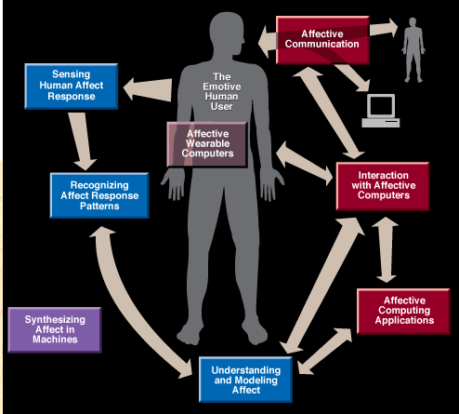
Why research Emotional Annotation of Text?
Opinion mining
Market analysis
Natural language interfaces
E-learning environments
Educational/edutainment games
Affective Computing
Artificial Intelligence
Pattern Recognition
Human-Computer Interaction

Slide 4

Sample Audio
Anger
Disgust
Gladness
Sadness
Fear
Surprise
Sample Sentences
I’m almost finished.
I saw your name in the paper.
I thought you really meant it.
I’m going to the city.
Look at that picture.
http://xenia.media.mit.edu/~cahn/emot-speech.html

Slide 5
Computational representations of emotions
Emotional Categories
Emotional Dimensions
Evaluation
Activation
Power
Plutchik’s Wheel

Slide 6
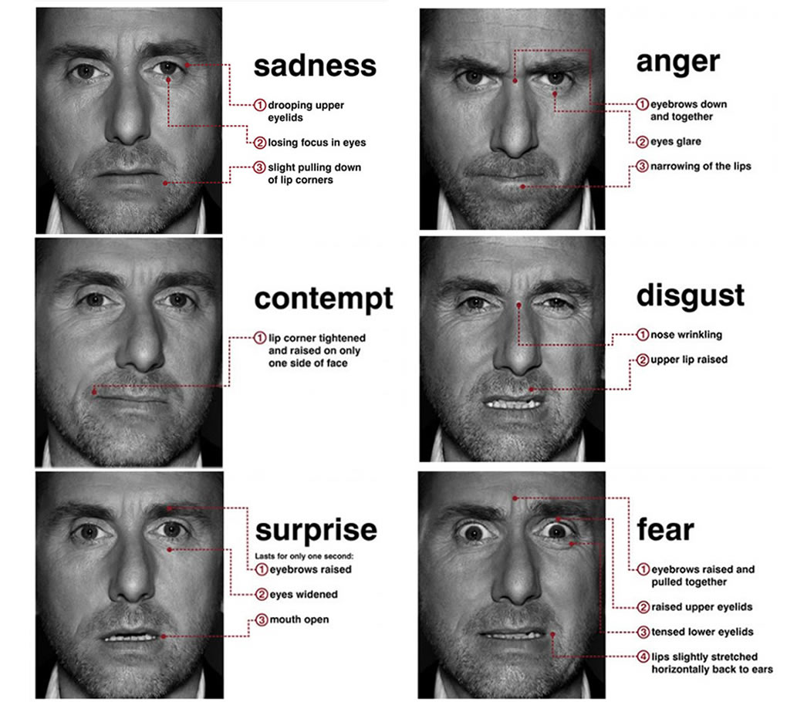
Varying emotion models
Plutchik (Plutchik’s Wheel)
Anger, anticipation, disgust, joy, fear, sadness, surprise and trust
Ekman (Distinct facial expressions)
Anger, disgust, fear, joy, sadness and surprise
Izard (Ten basic emotions)
Anger, contempt, disgust, distress, fear, guilt, interest, joy, shame and surprise
Ekman facial expressions

Slide 7
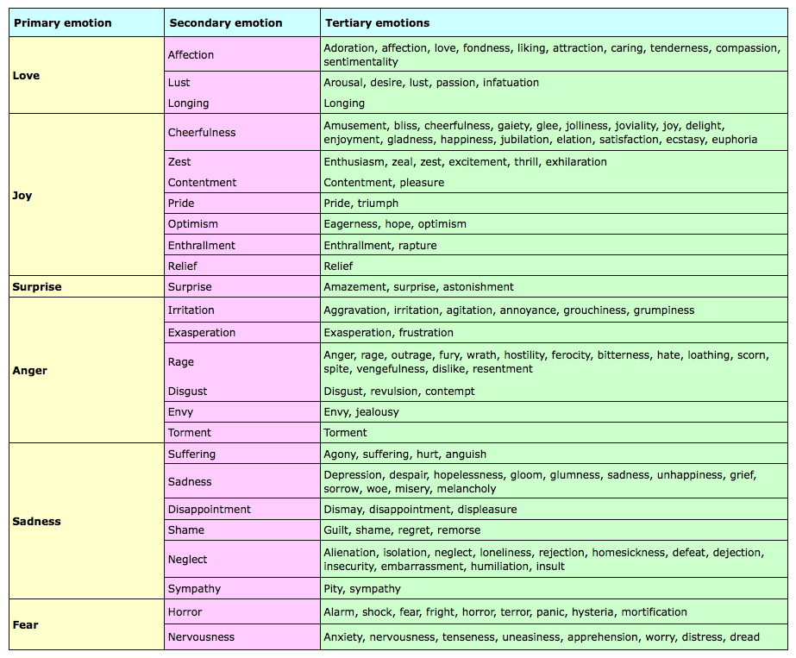
Varying emotion models, cont.
OCC Model (Emotional synthesis)
22 emotional categories…
Pride-shame, hope-fear, love-hate, ect
Parrot (Tree structure)
Primary emotions, secondary emotions and tertiary emotions
Love, joy, surprise, anger, sadness and fear
Parrot’s Tree

Slide 8
Emotional Annotation Process
Construct dataset
Apply emotional detection feature set
Apply “connotation” algorithm

Slide 9
Datasets
Text Affect Dataset
News headlines drawn from the most important newspapers, as well as from the Google News search engine
Training subset (250 annotated sentences)
Testing subset (1,000 annotated sentences)
Six emotions (anger, disgust, fear, joy, sadness and surprise)
Provides a vector for each emotion according to degree of emotional load
Neviarouskaya et al.’s Dataset
Sentences labeled by annotators
10 catigories (anger, disgust, fear, guilt, interest, joy, sadness, shame, and surprise and a neutral category)
Dataset 1
1000 sentences extracted from various stories in 13 diverse categories such as education, health, and wellness
Dataset 2
700 sentences from collection of diary-like blog posts

Slide 10
Datasets, cont.
Alm’s Dataset
Annotated sentences from fairy tales
Ekman’s list of basic emotions (happy, fearful, sad, surprised and angry-disgusted)
Aman’s Dataset
Annotated sentences collected from emotion-rich blogs
Ekman’s list of basic emotions (happy, fearful, sad, surprised, angry, disgusted and a neutral category)

Slide 11
Emotion detection in text
Bag-Of-Words (BOW)
Boolean attributes for each word in sentence
Words are independent entities (semantic information ignored)
N-grams
used for catching syntactic patterns in text and may include important text features such as negations, e.g., “not happy”

Slide 12
Emotion detection in text, cont.
Lexical
set of emotional words extracted from affective lexical repositories such as, WordNetAffect
WordNetAffect associates word with six basic emotions
Joy, enthusiasm, anger, sadness, surprise, neutral
Affective-Weight based on a semantic similarity

Slide 13
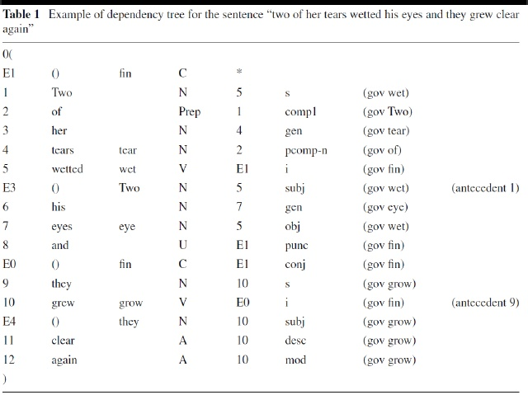
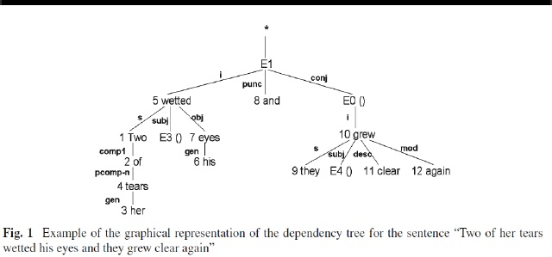
Dependency analysis
MINIPAR
“Two of her tears wetted his eyes and they grew clear again”
Nodes are numbered
Arcs between nodes is a dependency relation
Each dependency relation is labeled with a tag to ID the kind of relation

Slide 14
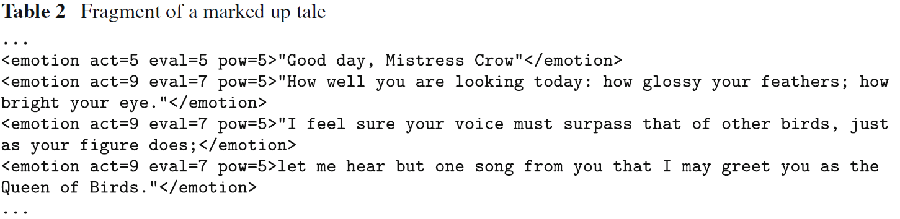
Automated mark up of emotions in text
EmoTag
Based on the emotional dimensions
Words are filtered using a stop list and dependency analysis used to identify scope of negation
Emotion value of word is looked up in an affective dictionary
Emotion value is inverted for words that were filtered for negation
Once all the words of the sentences have been evaluated, the average value for each dimension is calculated

Slide 15
Applying algorithms - Baseline
Weka
Collection of machine learning algorithms for data mining tasks. The algorithms can either be applied directly to a dataset or called from your own Java code.
Weka contains tools for data pre-processing, classification, regression, clustering, association rules, and visualization. It is also well-suited for developing new machine learning schemes.
Classifiers in Weka
Used for learning algorithms
Simple classifier: ZeroR
Tests how well the class can be predicted without considering other attributes
Can be used as a Lower Bound on Performance.

Slide 16
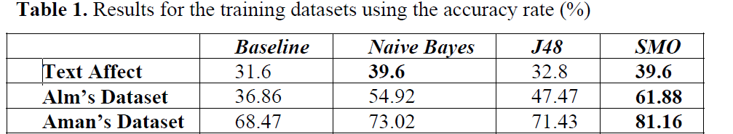
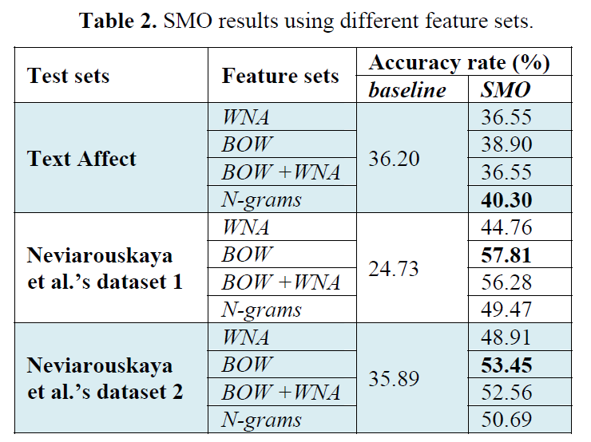
Applying algorithms
Accurate algorithm applied with different feature sets
Find accuracy of algorithm

Slide 17

Semantic Web technologies
"The Semantic Web provides a common framework that allows data to be shared and reused across application, enterprise, and community boundaries.“ –W3C

Slide 18
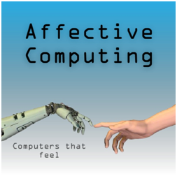
Conclusions
Technologies are available which allow us to develop affective computing applications
Need a framework for common application of feature sets and algorithms
Numerous fields within affective computing demand more research

Slide 19
Resources

Slide 20
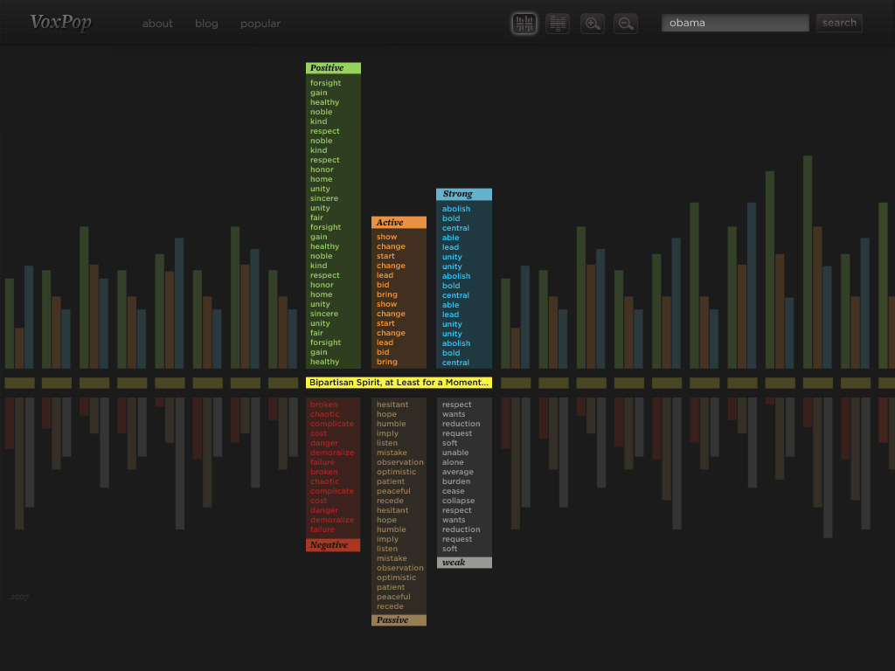
General Inquirer
http://www.wjh.harvard.edu/~inquirer/

Slide 21
www.analyzewords.com/index.php
www.analyzewords.com/index.php
BarackObama
mittromney

Slide 22
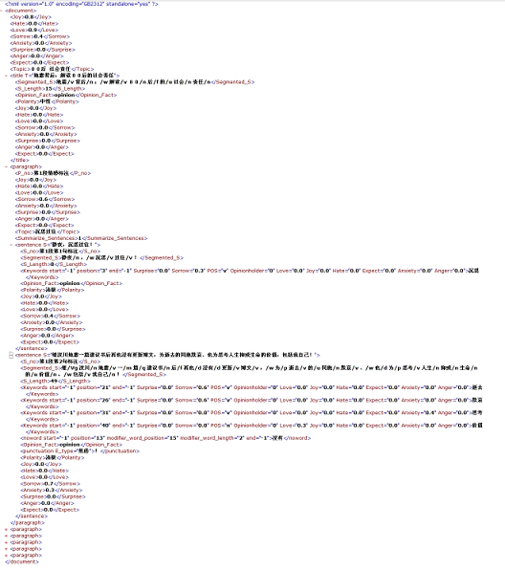

Slide 23
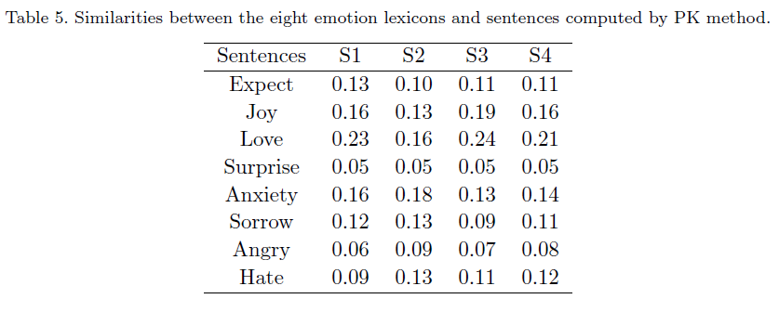
PK method
S1-S4 are examples of sentences and the emotions annotated by annotators.
S1): 我马上感觉到了她对女儿的思念之情。
English: I felt her strong yearnings toward her daughter right away.
Emotion (S1) = Love;
S2): 有多少人是快乐的呢？
English: How many people are happy?
Emotion (S2) = Anxiety, Sorrow;
S3): 她在同学中特别受欢迎。
English: She is greatly welcomed in her classmates.
Emotion (S3) = Love, Joy;
S4):这么美好的春光应该给人们带来温暖和欣慰，可是我的内心却冷冷作痛，
这是为什么呢？
English: Such pleasant spring sunshine should bring people with warm and gratefulness,
but I felt heartburn, why?
Emotion (S4) = Anxiety, Sorrow;
Table 5 shows examples of similarities between the eight emotion lexicons and
sentences computed by PK method. (The values of similarity
are normalized.)

